Slide 2
We teach our pupils the important role of Science in daily life and provide opportunities so that they better understand the world around them.
We provide learning opportunities inside and outside of the classroom so that, as well as knowledge and understanding, our pupils are taught how to work scientifically, and the application of Science.
We provide opportunities for pupil-led enquiry, investigations and problem solving.

Slide 3
Science encourages pupils to ask ‘how’ and ‘why’ questions, with the aim of finding out the answers.

Slide 4
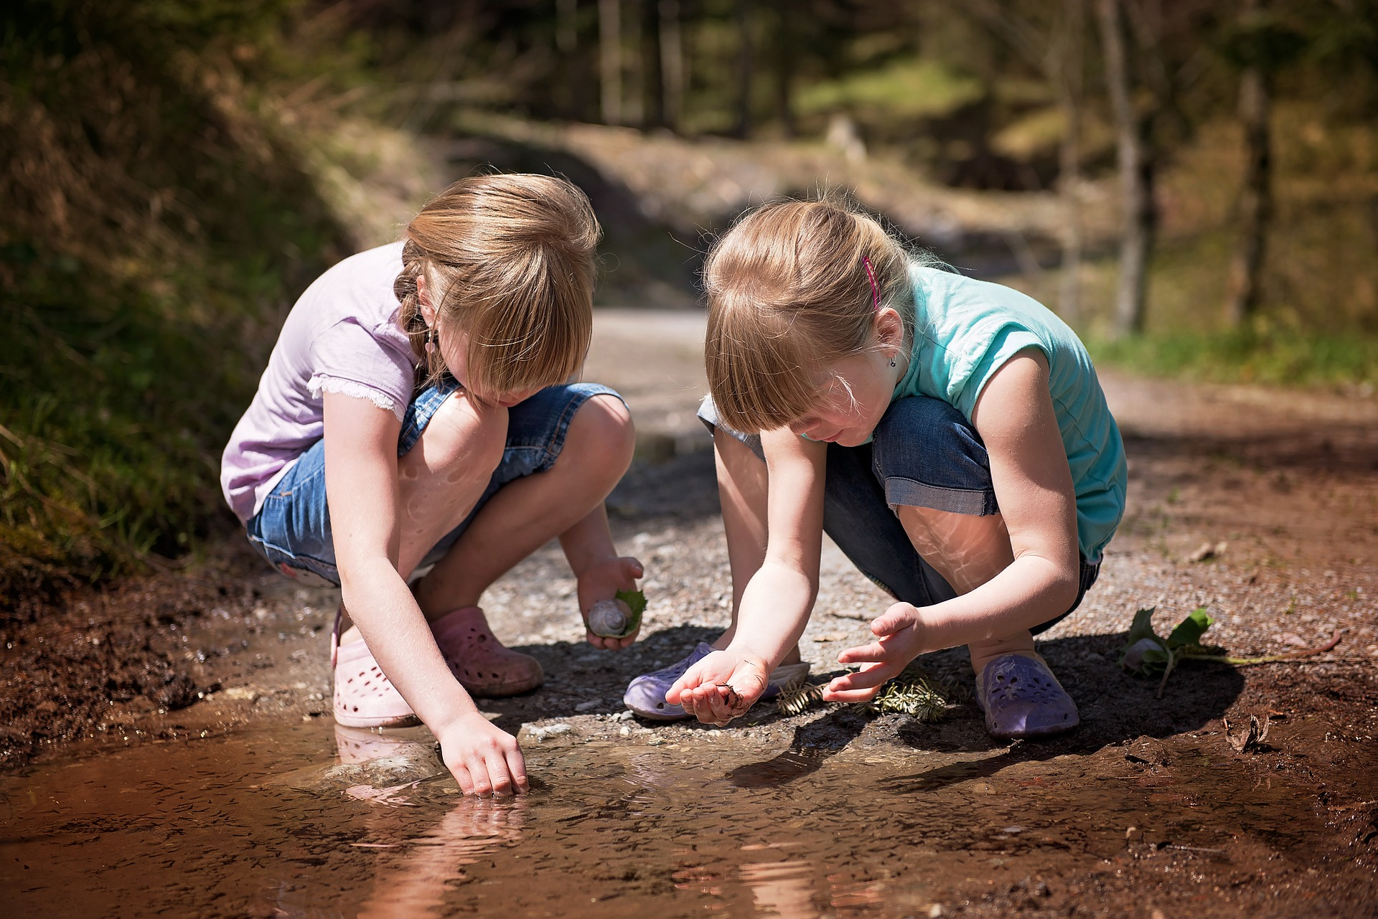
Science leads pupils on a journey of discovery, as they link isolated facts to form a coherent narrative about the natural world.

Slide 5
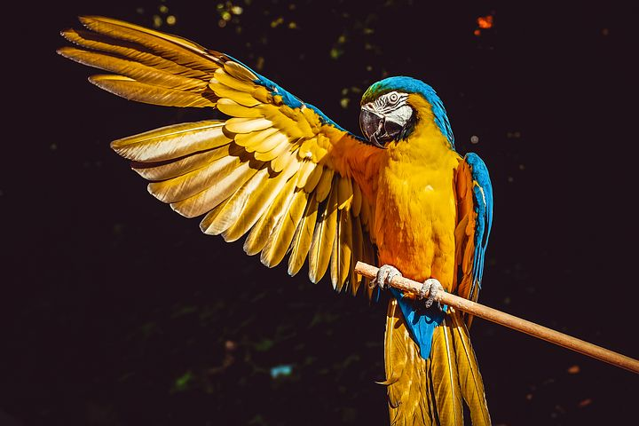
Science nurtures pupils’ natural curiosity and helps develop inquiring minds.

Slide 6
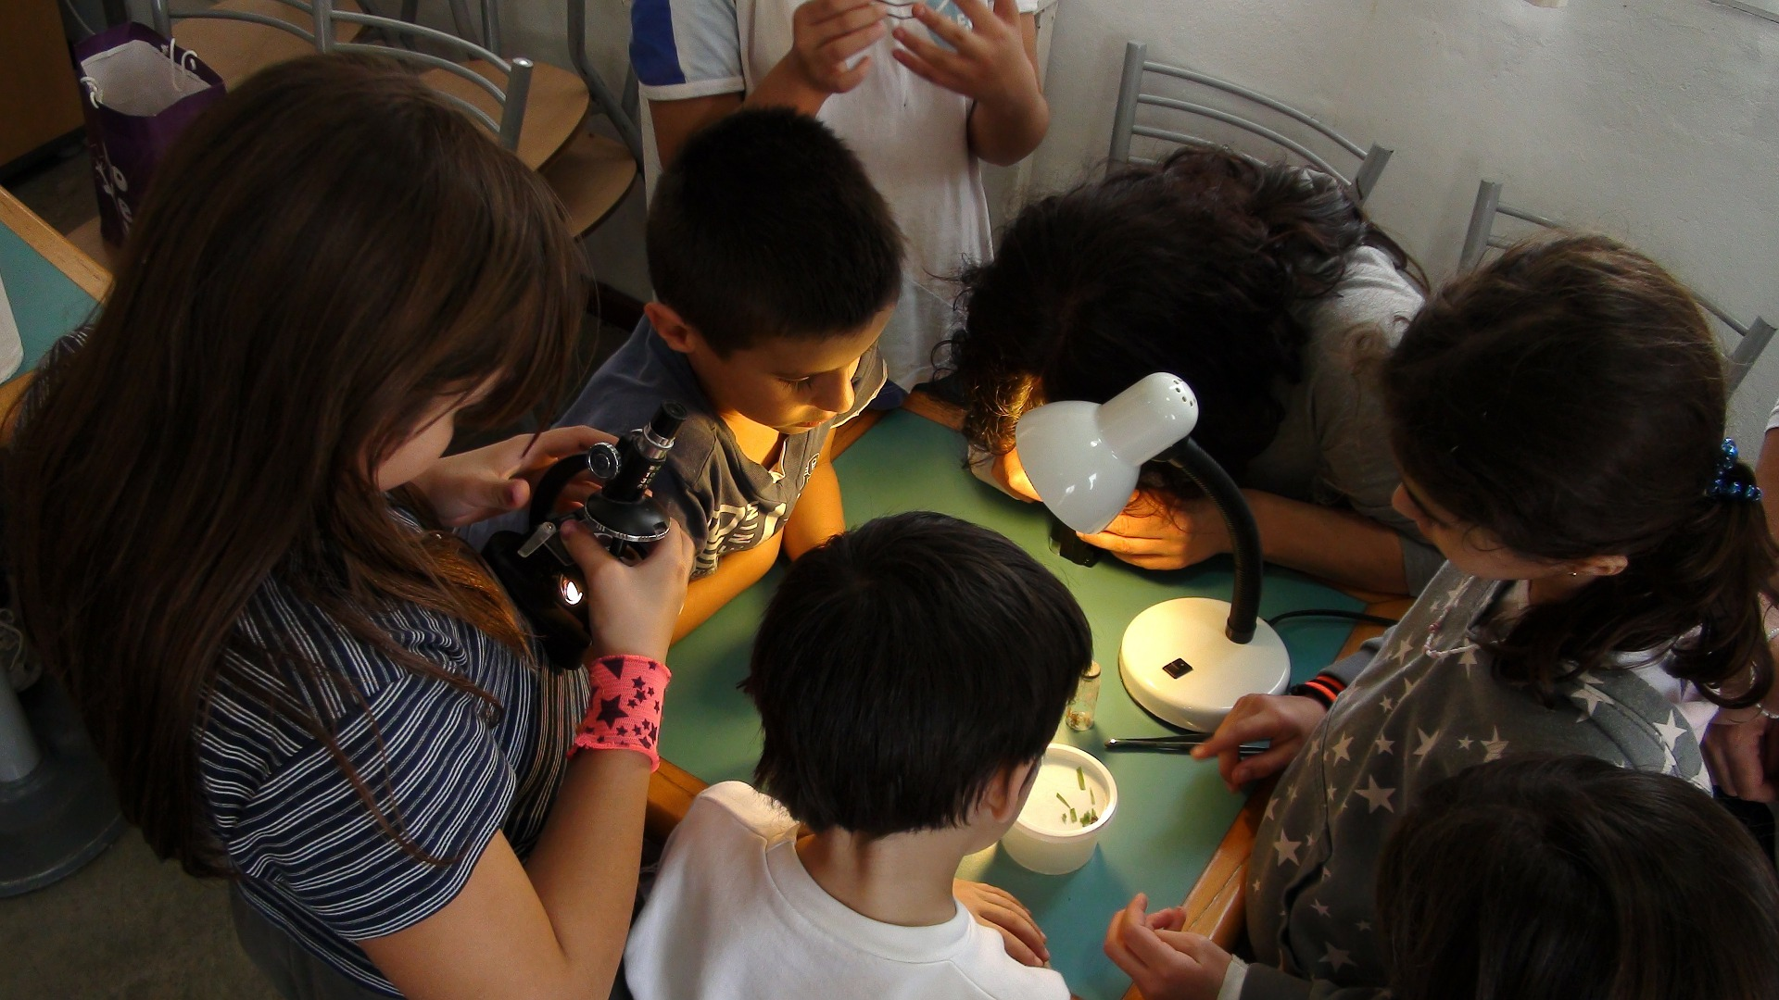
Practical experiments and investigations in Science teach the pupils the importance of accuracy and problem solving.

Slide 7
Science teaching opens up new ways of thinking which complement and/or challenge established ideas and knowledge.

